Slide 1
We will start shortly

Slide 2
CIS 9660 – Data Mining for Analytics
Week 6 Naïve Bayes (Classification)
Performance Evaluation
Prof. Arturo Castellanos
CIS Department Office: VC11-229

Slide 3
Lab 2 – Regression (Jupyter notebook)

Slide 4
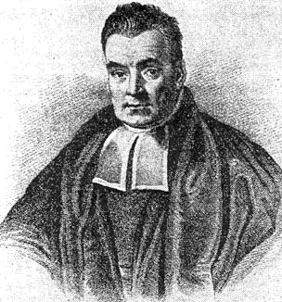
Characteristics
Data-driven, not model-driven
Makes no assumptions about the data
Named after mid-16th century English statistician and Presbyterian minister Thomas Bayes

Slide 5
Naïve Bayes: The Basic Idea
For a given new record to be classified, find other records like it (i.e., same values for the predictors)
What is the prevalent class among those records?
Assign that class to your new record

Slide 6
Usage
Requires categorical variables
Numerical variable must be binned and converted to categorical
Can be used with very large data sets
Example: Spell check programs assign your misspelled word to an established “class” (i.e., correctly spelled word)

Slide 7
Exact Bayes Classifier
Relies on finding other records that share same predictor values as record-to-be-classified.
Want to find “probability of belonging to class C, given specified values of predictors.”
Even with large data sets, may be hard to find other records that exactly match your record, in terms of predictor values.

Slide 8
Example: Financial Fraud
Target variable: Audit finds fraud, no fraud
Predictors:
Prior pending legal charges (yes/no)
Size of firm (small/large)

Slide 9
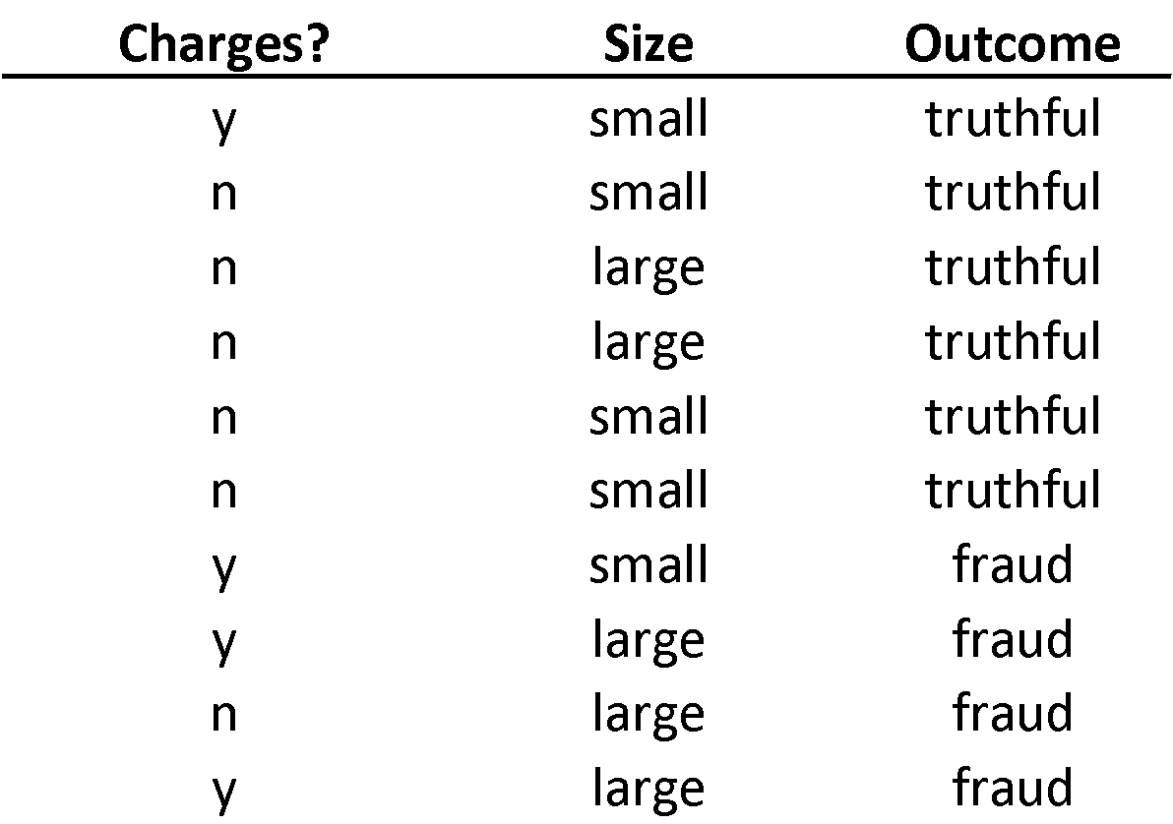

Slide 10
Exact Bayes Calculations
Goal: classify (as “fraudulent” or as “truthful”) a small firm with charges filed
There are 2 firms like that, one fraudulent and the other truthful
P(fraud | charges=y, size=small) = ½ = 0.50
Note: calculation is limited to the two firms matching those characteristics

Slide 11
Naïve Bayes Calculations
Same goal as before
Compute 2 quantities:
Proportion of “charges = y” among frauds, times proportion of “small” among frauds, times proportion frauds = 3/4 * 1/4 * 4/10 = 0.075
Prop “charges = y” among truthfuls, times prop. “small” among truthfuls, times prop. truthfuls = 1/6 * 4/6 * 6/10 = 0.067
P(fraud | charges, small) = 0.075/(0.075+0.067)
= 0.53

Slide 12
Independence Assumption
Not strictly justified (variables often correlated with one another)
Often “good enough” – ranking of probabilities is more important than unbiased estimate of actual probabilities

Slide 13
Advantages
Handles purely categorical data well
Works well with very large data sets
Simple & computationally efficient

Slide 14
Shortcomings
Requires large number of records
Problematic when a predictor category is not present in training data
Assigns 0 probability of response, ignoring information in other variables

Slide 15
Summary
No statistical models involved
Naïve Bayes (like KNN) pays attention to complex interactions and local structure
Computational challenges remain

Slide 16

Why Evaluate?
Multiple methods are available to classify or predict
For each method, multiple choices are available for settings
To choose best model, need to assess each model’s performance

Slide 17
Outcomes of Interest
Numerical value
For example: house price
Membership in a class
For example: buyer/non-buyer
“Propensity” - probability of belonging to a class
For example: the propensity to default (i.e., probability of class membership).

Slide 18
Python Functionality Needed
import math
import pandas as pd
from sklearn.model_selection import train_test_split
from sklearn.linear_model import LinearRegression
from sklearn.metrics import accuracy_score, roc_curve, auc
import matplotlib.pylab as plt
from dmba import regressionSummary, classificationSummary
from dmba import liftChart, gainsChart
Pandas -> data handling
Statsmodels -> regression models
Scikit-learn -> performance metrics
Matplotlib -> visualization

Slide 19

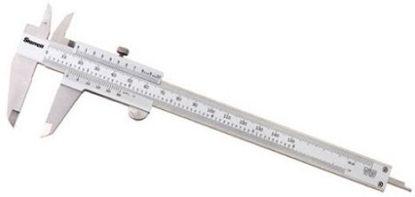
Evaluating Predictive Performance

Slide 20
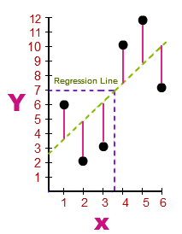
Some measures of error
MAE or MAD: Mean absolute error (deviation)
Gives an idea of the magnitude of errors
RMSE (root-mean-squared-error): Square the errors, find their average, take the square root
Total SSE: Total sum of squared errors
Source: https://math.tutorvista.com/
The best regression is the one that minimizes $\sum_{all}{{(actual −predicted)}^{2}}$
Training points
Predictions from regression
y = mx + b

Slide 21
Accuracy Measures (Classification)

Slide 22
Misclassification error
Error = classifying a record as belonging to one class when it belongs to another class.
Error rate = percent of misclassified records out of the total records in the validation data

Slide 23
Confusion Matrix, 3000 cases function: “classificationSummary” found in Appendix
 |  | Actual Class
 |  | 0 | 1
Predicted Class | 0 | 2689 | 85
 | 1 | 25 | 201 (TPs)
201 1’s correctly classified as “1” (True Positives)
85 1’s incorrectly classified as “0” (False Negatives)
25 0’s incorrectly classified as “1” (False Positives)
2689 0’s correctly classified as “0” (True Negatives)

Slide 24
Error Rate
 |  | Actual Class
 |  | 0 | 1
Predicted Class | 0 | 2689 | 85
 | 1 | 25 | 201
Overall error rate = (25+85)/3000 = 3.67%
Accuracy = 1 – err = (201+2689) = 96.33%
If there are multiple classes, the error rate is:
(sum of misclassified records)/(total records)

Slide 25
Cutoff for classification
Most DM algorithms classify via a 2-step process:
For each record,
Compute probability of belonging to class “1”
Compare to cutoff value, and classify accordingly
Default cutoff value is 0.50
If >= 0.50, classify as “1”
If < 0.50, classify as “0”
Can use different cutoff values
Typically, error rate is lowest for cutoff = 0.50

Slide 26
Confusion Matrix for Different Cutoffs
predicted = ['owner' if p > 0.5 else 'nonowner' for p in
owner_df.Probability]
classificationSummary(owner_df.Class, predicted, class_names=['nonowner', 'owner'])
Confusion Matrix (Accuracy 0.8750)
Prediction
Actual nonowner owner
nonowner 10 2
owner 1 11
cutoff = 0.25 (Accuracy 0.7917)
Prediction
Actual nonowner owner
nonowner 8 4
owner 1 11
Cutoff 0.75 (Accuracy 0.7500)
Prediction
Actual nonowner owner
nonowner 11 1
owner 5 7

Slide 27
When One Class is More Important
In many cases it is more important to identify members of one class
Tax fraud
Credit default
Response to promotional offer
Detecting electronic network intrusion
Predicting delayed flights
In such cases, we are willing to tolerate greater overall error, in return for better identifying the important class for further attention

Slide 28
Alternate Accuracy Measures
 |  | Actual Class
 |  | 0 | 1
Predicted Class | 0 | 2689 | 85
 | 1 | 25 | 201 (TPs)
What would be the Precision, Recall, and f-measure for this model?

Slide 29

ROC’s are one way to measure a model’s effectiveness in separating the “wheat from the chaff”
“Lift” (“gains”) is a similar metric, but measuring “how much does the model improve on random chance in finding the class of interest”

Slide 30
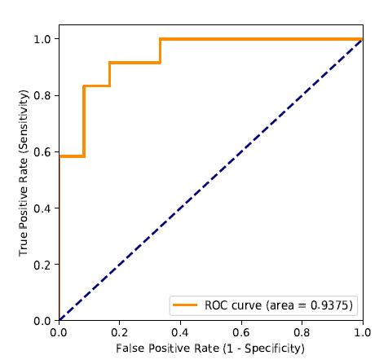
ROC Curve (library roc_curve)
Area under the ROC curve (“AUC,” function auc) is a useful metric
Diagonal reflects random classification on a sliding probability, from 0 to 1, of labeling a record as a “1”
Other software sometimes plots x-axis as “specificity” with 1 on left, 0 on right.

Slide 31
Lift (also termed “gains”): Goal
Evaluates how well a model identifies the most important class
Helps evaluate, e.g.,
How many tax records to examine
How many loans to grant
How many customers to mail offer to

Slide 32
Lift (Gains): How to Compute
Using the model’s output, sort records from most likely to least likely members of the important class
Compute lift: Accumulate the correctly classified “important class” records (Y axis) and compare to number of total records (X axis)

Slide 33
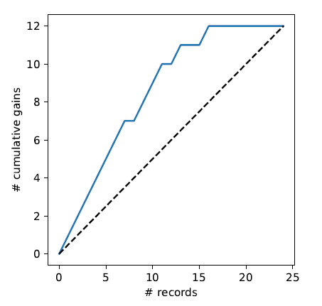
Lift (Gains) Chart – cumulative performance
After examining (e.g.) 10 cases (x-axis), 9 owners (y-axis) have been correctly identified
Lift = 9/5 = 1.8
Compared to:
12/24 = 0.5 * 10 = 5
df = pd.read_csv('liftExample.csv')
df = df.sort_values(by=['prob'], ascending=False)
gainsChart(df.actual, figsize=(4, 4))

Slide 34
Lift (gains) vs. ROC curve
Gains and ROC curves have similar appearance
ROC curve and AUC provide a widely used single metric and visual to assess a model’s ability to separate classes overall
Lift (gains) yields intuitive measure of model performance at different cutoffs, but no overall metric
Notes:
34

Slide 35

Asymmetric Costs

Slide 36
Misclassification Costs May Differ
The cost of making a misclassification error may be higher for one class than the other(s)
Looked at another way, the benefit of making a correct classification may be higher for one class than the other(s)

Slide 37
Example – Response to Promotional Offer
Suppose we send an offer to 1000 people, with 1% average response rate (“1” = response, “0” = nonresponse)
“Naïve rule” (classify everyone as “0”) has error rate of 1% (seems good)
Using DM we can correctly classify eight 1’s as 1’s
It comes at the cost of misclassifying twenty 0’s as 1’s and two 1’s as 0’s.

Slide 38
Example (cont.)
The Confusion Matrix*
 | Actual 0 | Actual 1
Predicted 0 | 970 | 2
Predicted 1 | 20 | 8
Error rate = (2+20) = 2.2% (higher than naïve rate)
*confusion matrix is often shown with predictions as rows, actuals as columns, the reverse of what Python produces

Slide 39
Introducing Costs & Benefits
Suppose:
Profit from a “1” is $10
Cost of sending offer is $1
Then:
Under naïve rule, all are classified as “0”, so no offers are sent: no cost, no profit
Under DM predictions, 28 offers are sent.
8 respond with sale of $10 each
20 fail to respond, cost $1 each
972 receive nothing (no cost, no profit)
Net profit = $60

Slide 40
Profit Matrix
 | Actual 0 | Actual 1
Predicted 0 | $0 | $0
Predicted 1 | ($20) | $80

Slide 41
Generalize to Cost Ratio
Sometimes actual costs and benefits are hard to estimate
Need to express everything in terms of costs (i.e., cost of misclassification per record)
Goal is to minimize the average cost per record
A good practical substitute for individual costs is the ratio of misclassification costs (e,g,, “misclassifying fraudulent firms is 5 times worse than misclassifying solvent firms”)

Slide 42
Note: Opportunity costs
As we see, best to convert everything to costs, as opposed to a mix of costs and benefits
E.g., instead of “benefit from sale” refer to “opportunity cost of lost sale”
Leads to same decisions, but referring only to costs allows greater applicability

Slide 43
Lab 3
Problem statement
Lab time

